Slide 1
Excavation & Trenching

Slide 2
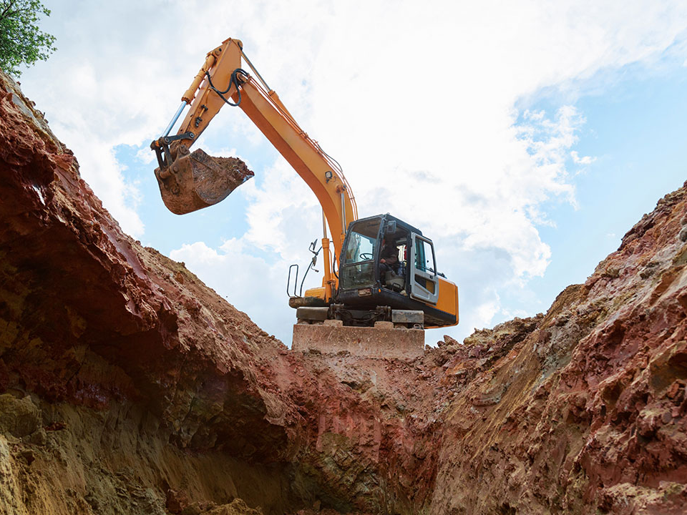
Introduction
The number of deaths related to trenching and excavation continues to be substantial
Excavations are considered one of the most perilous jobs in the construction industry
It is the employer’s responsibility to ensure that workers are adequately trained and protected before entering an excavation
This course will address potential hazards one can encounter in an excavation, and how to clearly identify and protect oneself from those hazards

Slide 3
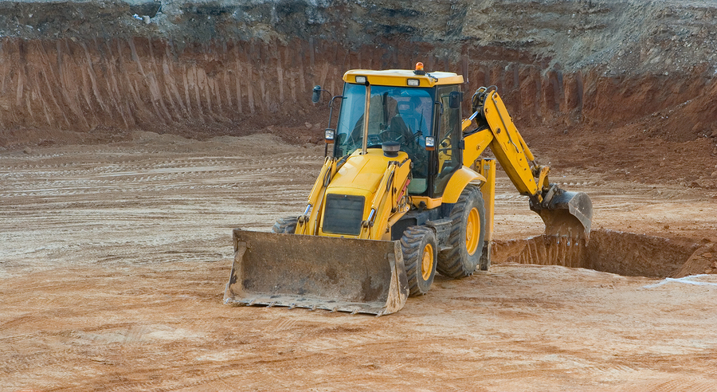
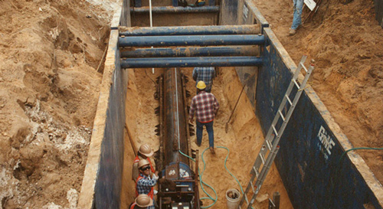
An Excavation is any man-made pit, hole, or trench created in the ground by removing earth
A trench is a specific type of excavation which tends to be narrower than it is wide

Slide 4
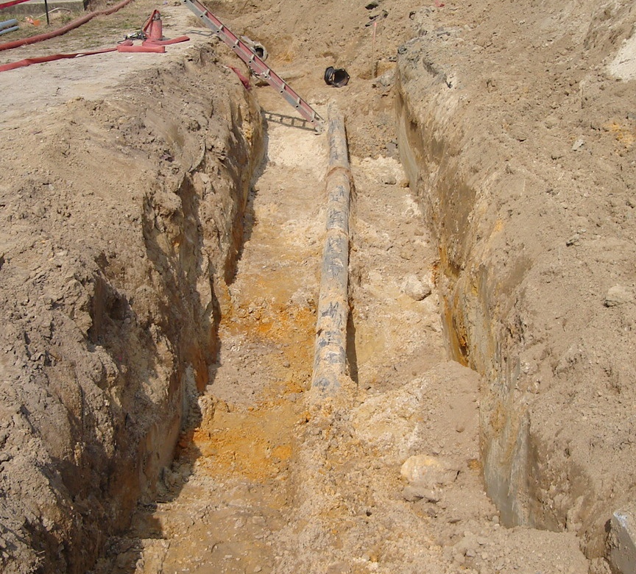
Trench Anatomy
Spoil
LIP
Lip
Spoil
Belly
Floor
Toe
BELLY
FLOOR
TOE

Slide 5
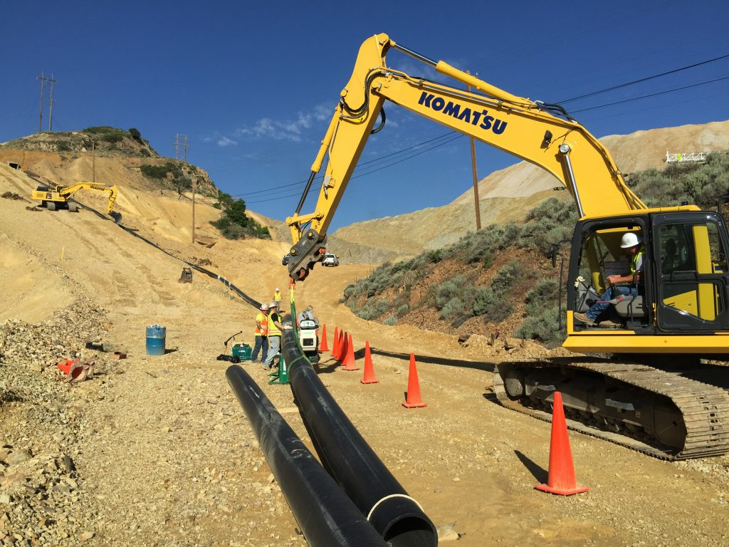
Special Requirements
Competent Person & Inspection Requirements
Utility Location and Management
Access & Egress
Traffic Exposure & Protection
Falling Object Protection and Fall Exposures
Hazardous Atmospheres
De-watering
Utility securing
Surface Encumbrances
Public Protection
Soil Analysis & Typing
Protective Systems

Slide 6
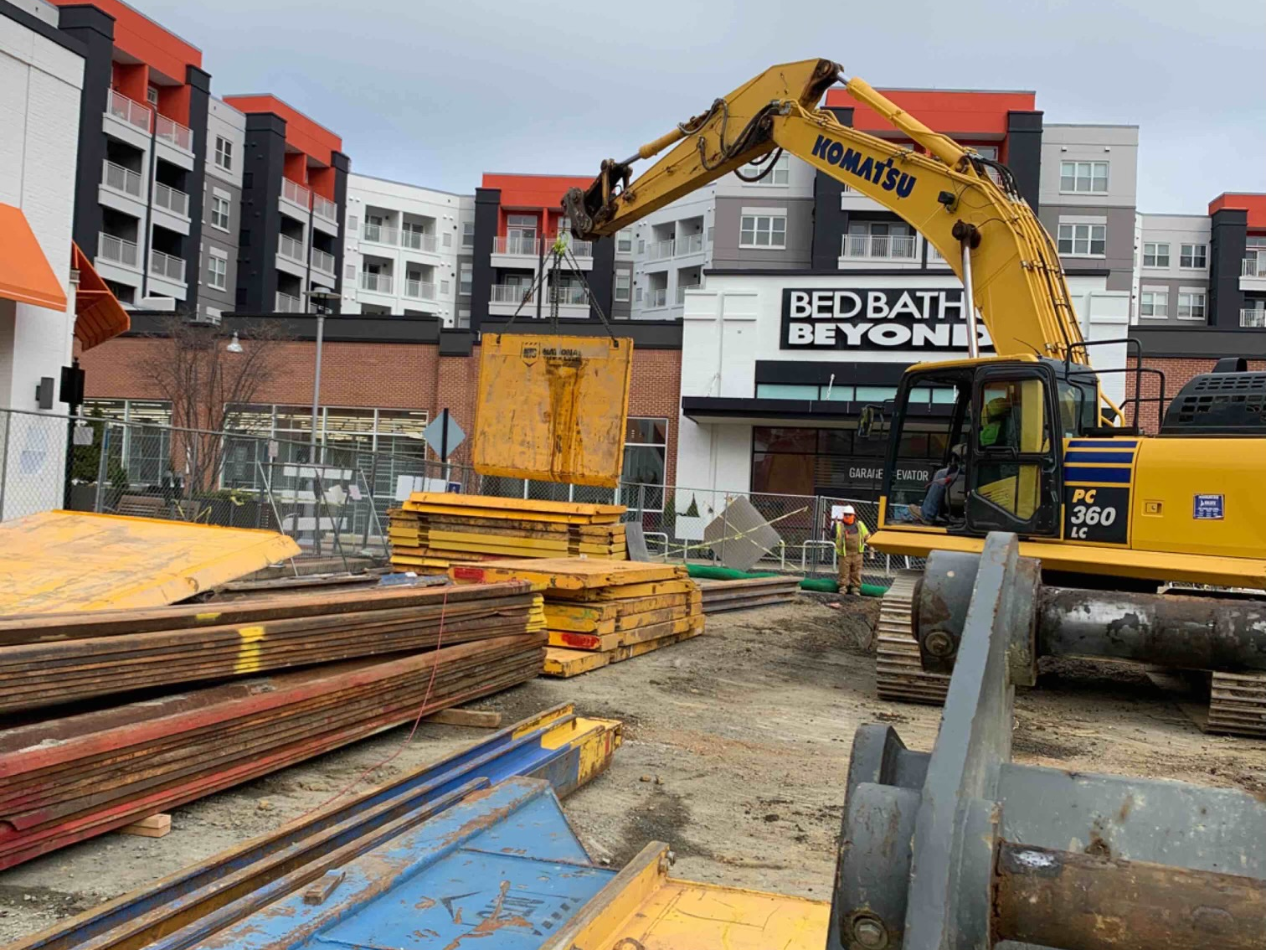
Competent Person
Capable of identifying existing and predictable hazards in the surroundings, or working conditions which are unsanitary, hazardous, or dangerous to employees
Has the authority to take prompt corrective measures to eliminate them.
Must be present at all times if workers are inside an excavation/trench.
Must be familiar with all the equipment that is being used.

Slide 7
Inspection
Trenches and Excavations should be inspected:
  Daily, before work begins
  After weather events
  If there is a change in the protective system
  By a competent person
Notes:
Prior to work starting. Prior to anyone entering an excavation a competent person should determine that all hazards have been accounted for and mitigated.
After any weather events. Weather events could change the layout and stability of a trench/excavation. Therefore, after all weather events the excavation should be re-inspected to determine that the weather has not caused any changes in condition.
If there have been any changes in the protective system the excavation will need to be inspected again. This should include a detailed inspection of all the components of the protective system that is implemented.
As needed throughout the shift

Slide 8
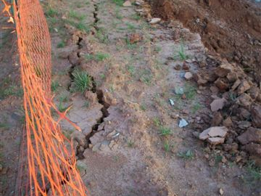
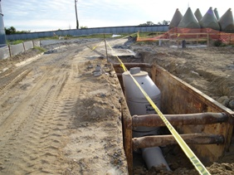
Inspection Criteria
Fissures present, indicating the movement of soil.
What to look for?
Surface Encumbrances
Equipment Placement
Obvious Hazards
Special Equipment Needs
Mitigation Measures
Traffic exposures – Protective system needed
Notes:
Surface encumbrances – these surface encumbrances could involve the following: Equipment, structures, tools, materials, soil, fill material and/or fill stone boxes.
Equipment placement – the location of the equipment can play a vital role in preventing collapses. When inspecting the CP should ensure that equipment is not located in a position that would put added stress on the belly of an excavation.
Obvious hazards – these could include material and/or water showing up inside of an excavation and/or cracks or fissures indicating the movement of the soil, etc.
Special equipment needs – example would be hydraulic hoses needing to be secured.
Mitigation measures – Inspect to ensure there have been measures implemented to mitigate any identified hazards. Such much measures could include shoring or sloping to prevent collapse.

Slide 9
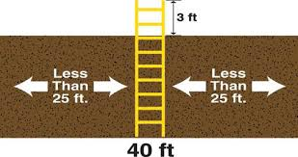
Access & Egress
Installed for excavations & trenches 4ft in depth or greater
Placed to allow sufficient access/egress without obstructions
Cannot exceed 25 ft of required travel for workers
Can be provided by ladders or ramps

Slide 10
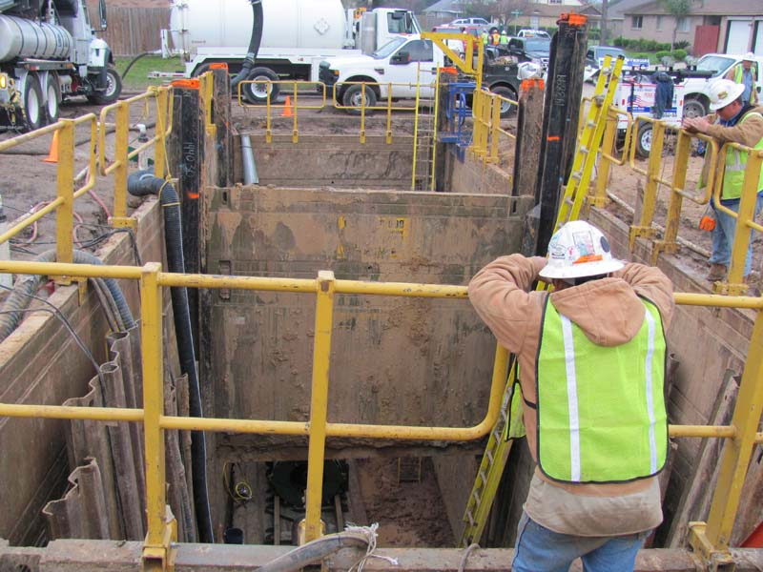
Fall Exposures
Protecting employees from falling into open excavations
Excavations 6ft in depth or greater should be guarded by a fall protection system
Fall exposures should be barricaded to prevent access to employees and the public

Slide 11
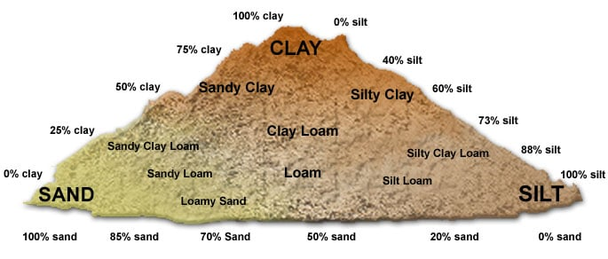
Type A Soil
UCS of 1.5 Tons or Greater
Clay & Silty Clay
Cohesive Soils with good moisture
content
Does not include:
Fissured soil
Previously Disturbed
Subject to vibration
Has poor material below it (Layered Soil)
Notes:
UCS – Unified Soil Classification System

Slide 12
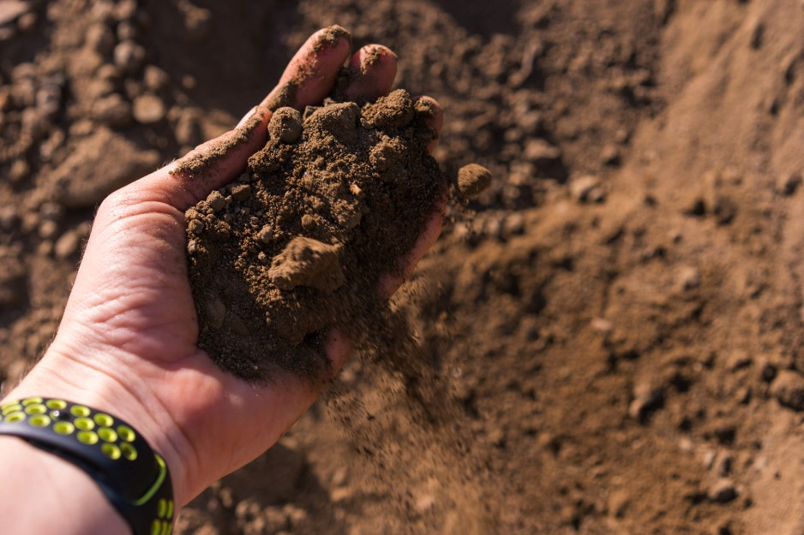
Type B Soil
UCS of 1.5 tons to 0.5 tons
Cohesive soils
Type A fissured
Granular Soils
Sandy & Silty Loam
Can be part of a layered soils

Slide 13
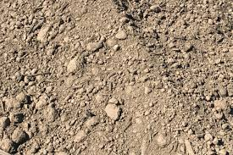
Type C 60 Soil
UCS of less than 0.5
Gravel, sand and loam composites
Submerged rock (rock deposits)
Water seeping from soil
Notes:
Type C-60 soil" refers to a soil classification that falls between Type B and Type C soils according to OSHA standards, essentially meaning it's a moderately unstable soil that can stand upright for a short period, allowing for shoring installation, but still requires significant support due to its tendency to crumble or slide easily; it is often described as a moist, cohesive or dense granular soil with an unconfined compressive strength less than 0.5 tons per square foot.

Slide 14
Soil Analysis & Testing
OSHA requirements for soil analysis
  1 visual test
  1 manual test
  Documentation and validation of soil testing
Manual Test
  Pocket Penetrometer
  Shear Vane
  Plasticity
  Sedimentation
  Thumb Penetration
  Dry Strength Test

Slide 15
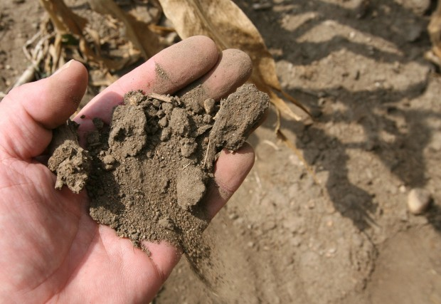
Type C 80 Soil
Unstable Material
AKA (Sugar Sand)
Water intrusion
Notes:
C-80 soil is a type of soil that has an equivalent weight of 80 pounds per square foot (psf) per foot of depth. It is a cohesive soil with a low unconfined compressive strength

Slide 16
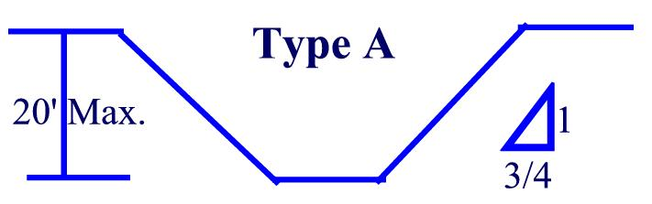
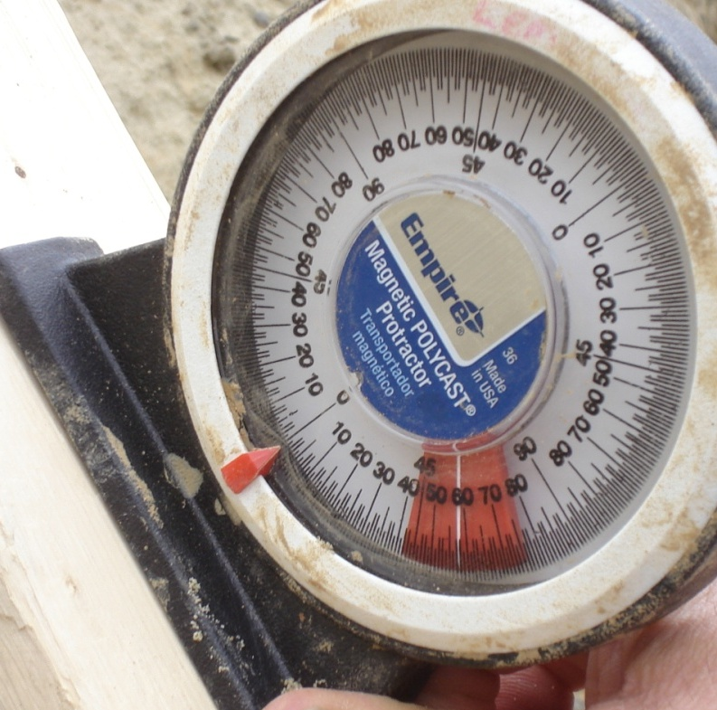
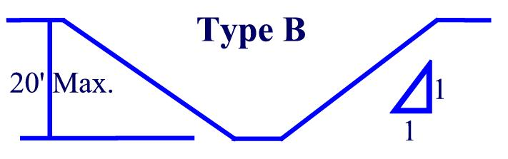
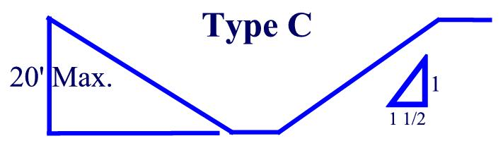
Sloping
Allowed for all Soil Types
Type A: ¾ to 1
  (54 degrees)
Type B: 1 to 1
  (45 degrees)
Type C: 1 ½ to 1
  (34 degrees)

Slide 17
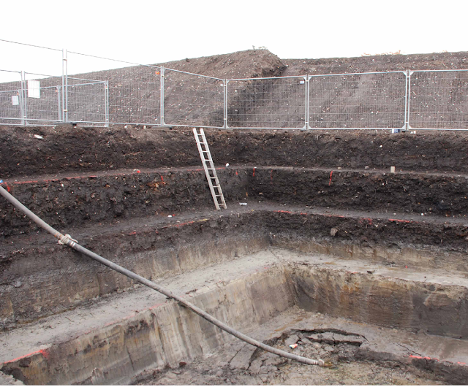
Benching
Feasible for Type A & B Soils only
Type C Soil is not allowed
Must be constructed in accordance with Subpart P

Slide 18
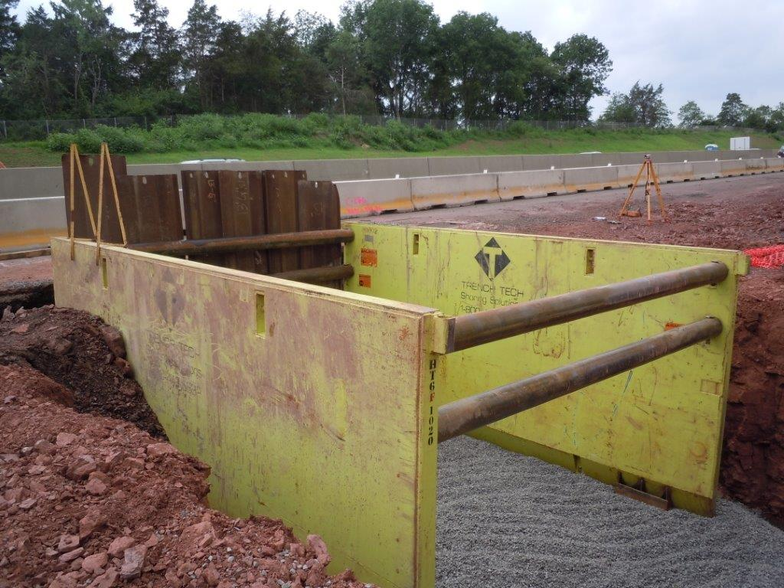
Shielding
Trench Boxes
Steel Plates
Combinations of Protective Systems

Slide 19
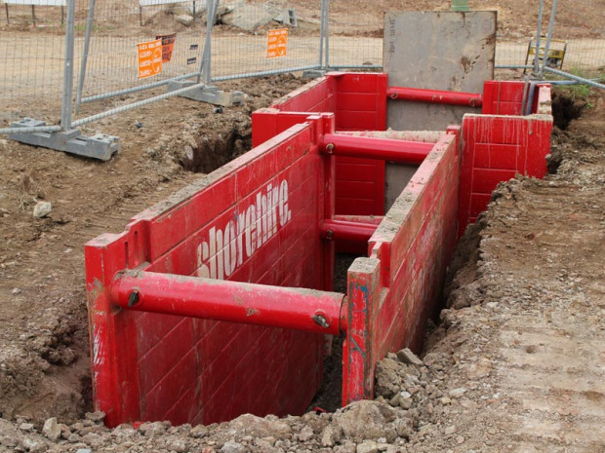
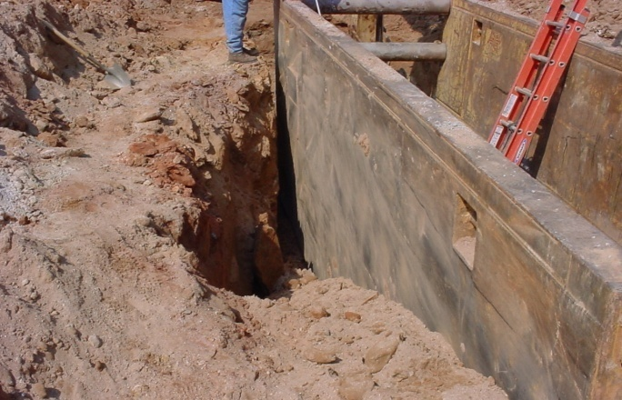
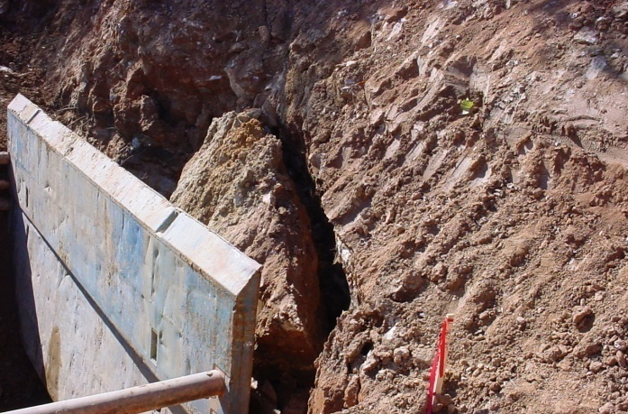
Shielding
Common Failures
Does NOT protect against soil failures
Does NOT allow anyone to work outside the protection of the system being used
Must be used in accordance with manufacturer recommendations
*The spacing between the sides of the excavation and the trench box should be backfilled with soil or other similar material to prevent the movement of the trench box.

Slide 20
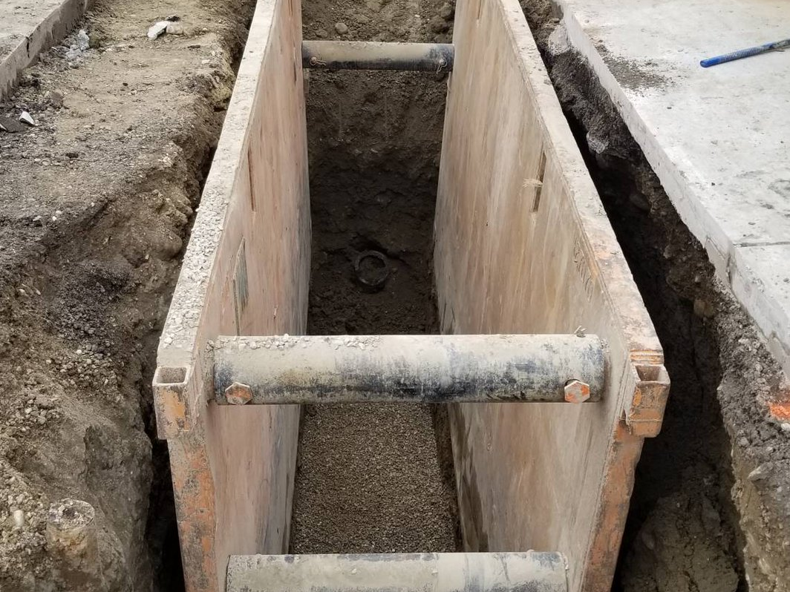
Trench Boxes
Unlike a shoring system, trench box's primary purpose is NOT to support the face of the trench.
Primary purpose is to protect worker’s inside from cave-ins
Braces/Spreaders must be approved material by manufacturer
Braces must be free of damage
Safety Pins must be in place
Adequate access must be provided

Slide 21
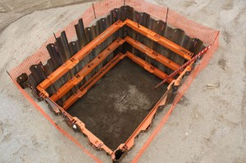
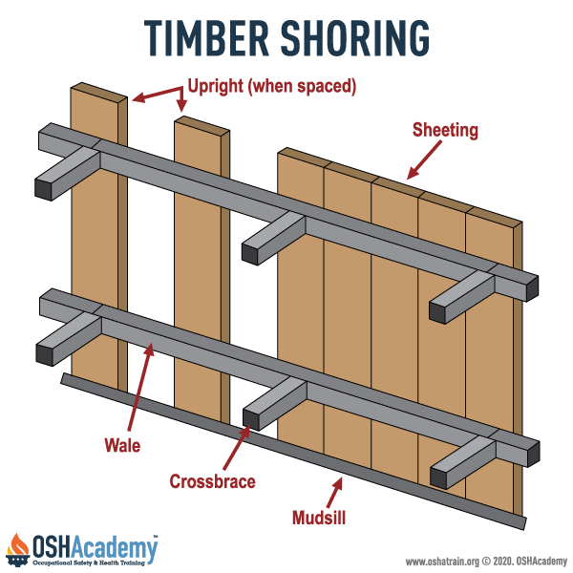
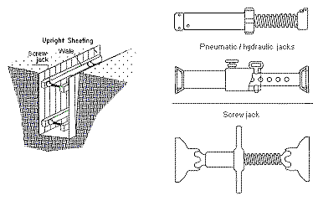
Shoring Systems
Shoring Types
Sheet Pile
Pneumatic Struts
Hydraulic Struts
Screw Jack Struts
Timber Shoring
Lagging
Engineered Systems
Reasons to Shore
Utilized when protecting of adjacent buildings
Protecting existing systems (sidewalks, roadways, etc.)
Real-estate is not available to utilize conventional systems
May reduce $ to straight cut and shore verses sloping or shielding

Slide 22
Shielding VS Shoring
Shielding does not protect against soil failures (trench box)
Shoring systems support the face of the trench, shielding systems do not
The primary purpose of a shielding system is to protect workers inside from potential collapse

Slide 23
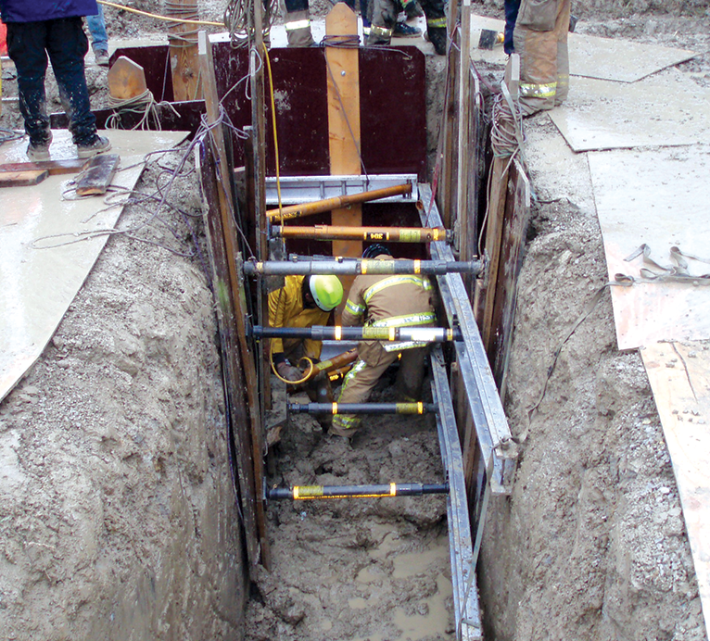
Rescue Scenarios
Always have a Plan
Consider all hazards and how likely they are to occur
What means of rescue are available?
Some remote areas are not afforded the luxury of having a trained crew nearby, therefore other arrangements should be considered

Slide 24
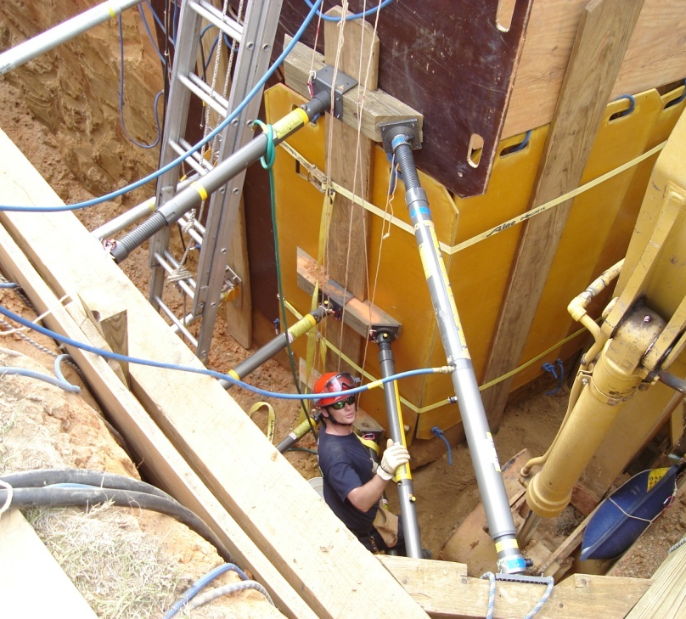
Rescue
Rescue typically =‘s Recovery
Most rescues/recovery takes approximately 4-6 hours
Rescuers must protect themselves before they can help the workers
Rescues are equipment & labor intensive

Slide 25
The Numbers Surrounding Excavations
20 Feet – Engineered protection system is required
6 Feet – Fall protection is needed around the excavation
5 Feet –Excavations 5 feet deep or greater must be shored, sloped, benched or shielded to protect workers
4 Feet – Access/Egress must be established for employees working in excavations
3 Feet – If a ladder is used for access, it must extend 3ft past the landing
2 Feet – Spoil piles must be maintained 2 ft from the edge of the excavation

Slide 26
Case Study 1
You must dig a 5ft deep excavation in class C Soil.
What must be done?

Slide 27
Case Study 2
You must dig an 8ft deep excavation in class A Soil.
What must be done?

Slide 28
Case Study 3
You must enter an existing trench after lunch. Earlier in the day there was a short rainstorm?
What must be done?

Slide 29
Questions?

